Slide 1
HW2
FE & EDA Assignment
APANPS5420 Anomaly Detection
Zhenyu Wang

Slide 2
Part 1: Summary of "Data mining for credit card fraud: A comparative study"
— by Siddhartha Bhattacharyya et al.
Support Vector Machines (SVMs) and Random Forests are effective techniques for credit card fraud detection.
Random undersampling of the majority class can help deal with imbalanced data.
Parameter tuning, such as the cost parameter in SVMs, is important for optimal performance.
Traditional performance measures like accuracy and AUC may not adequately address the specific requirements of fraud detection applications.
In fraud detection, the costs of false positives and false negatives are different, and performance measures should consider these costs.
The proportion of fraud cases among the top-ranked cases can be used to assess model performance.
Derived attributes can provide information on cardholders' buying behavior and help improve fraud detection.
The study has limitations, such as the lack of time stamp data for transactions.

Slide 3
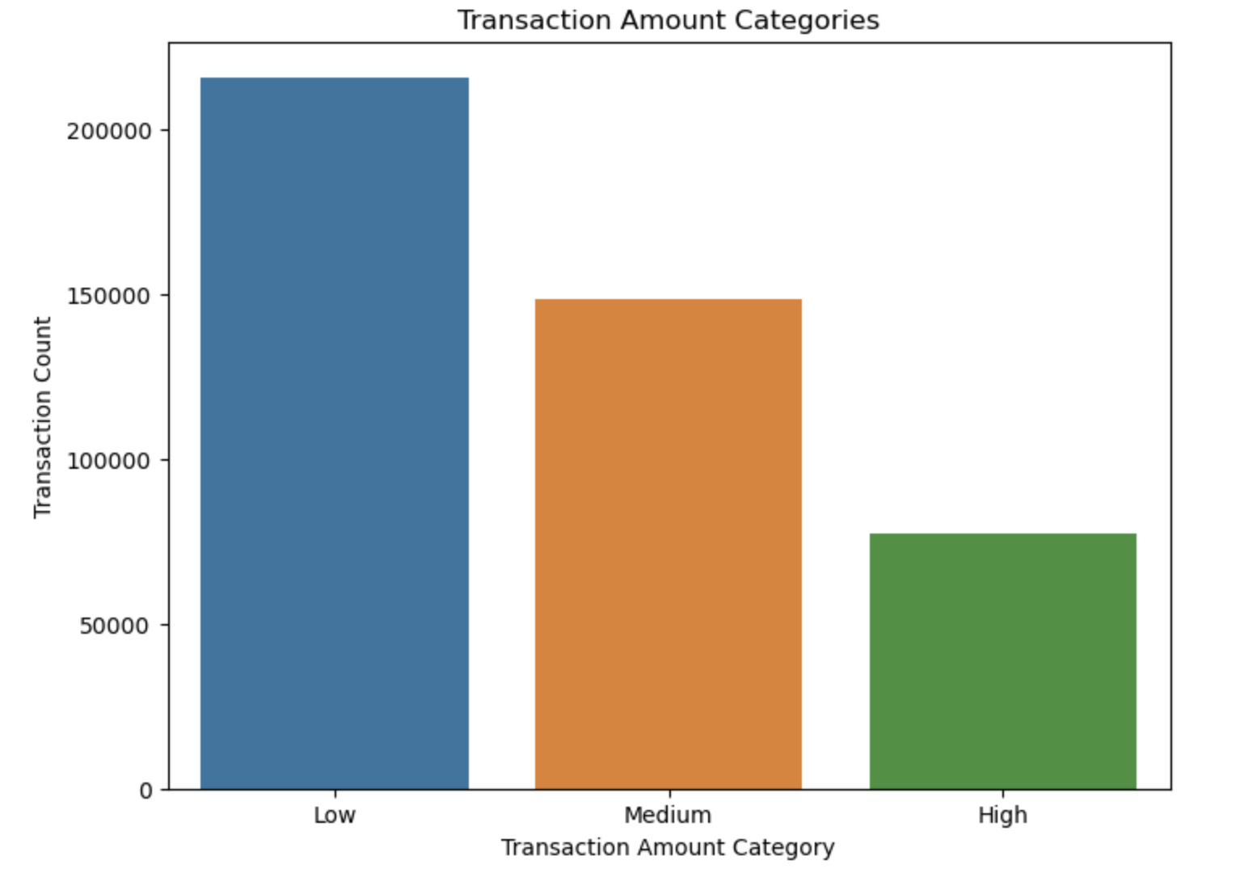
Part2: Exhaustive EDA Summary
01
Transaction Amount Analysis
Transaction Amount Distribution: The majority of transactions fall within the "Low" category, followed by "Medium" and "High" categories.
Unusual Transaction Amounts: Some transactions have unusually high or low amounts compared to the norm. These anomalies may warrant further investigation.
"Low" includes transactions with relatively small amounts (less than $100), often comprising everyday expenses.
"Medium" encompasses moderately-sized transactions (from $100 to $500).
"High" consists of larger transactions ($500 or more).

Slide 4
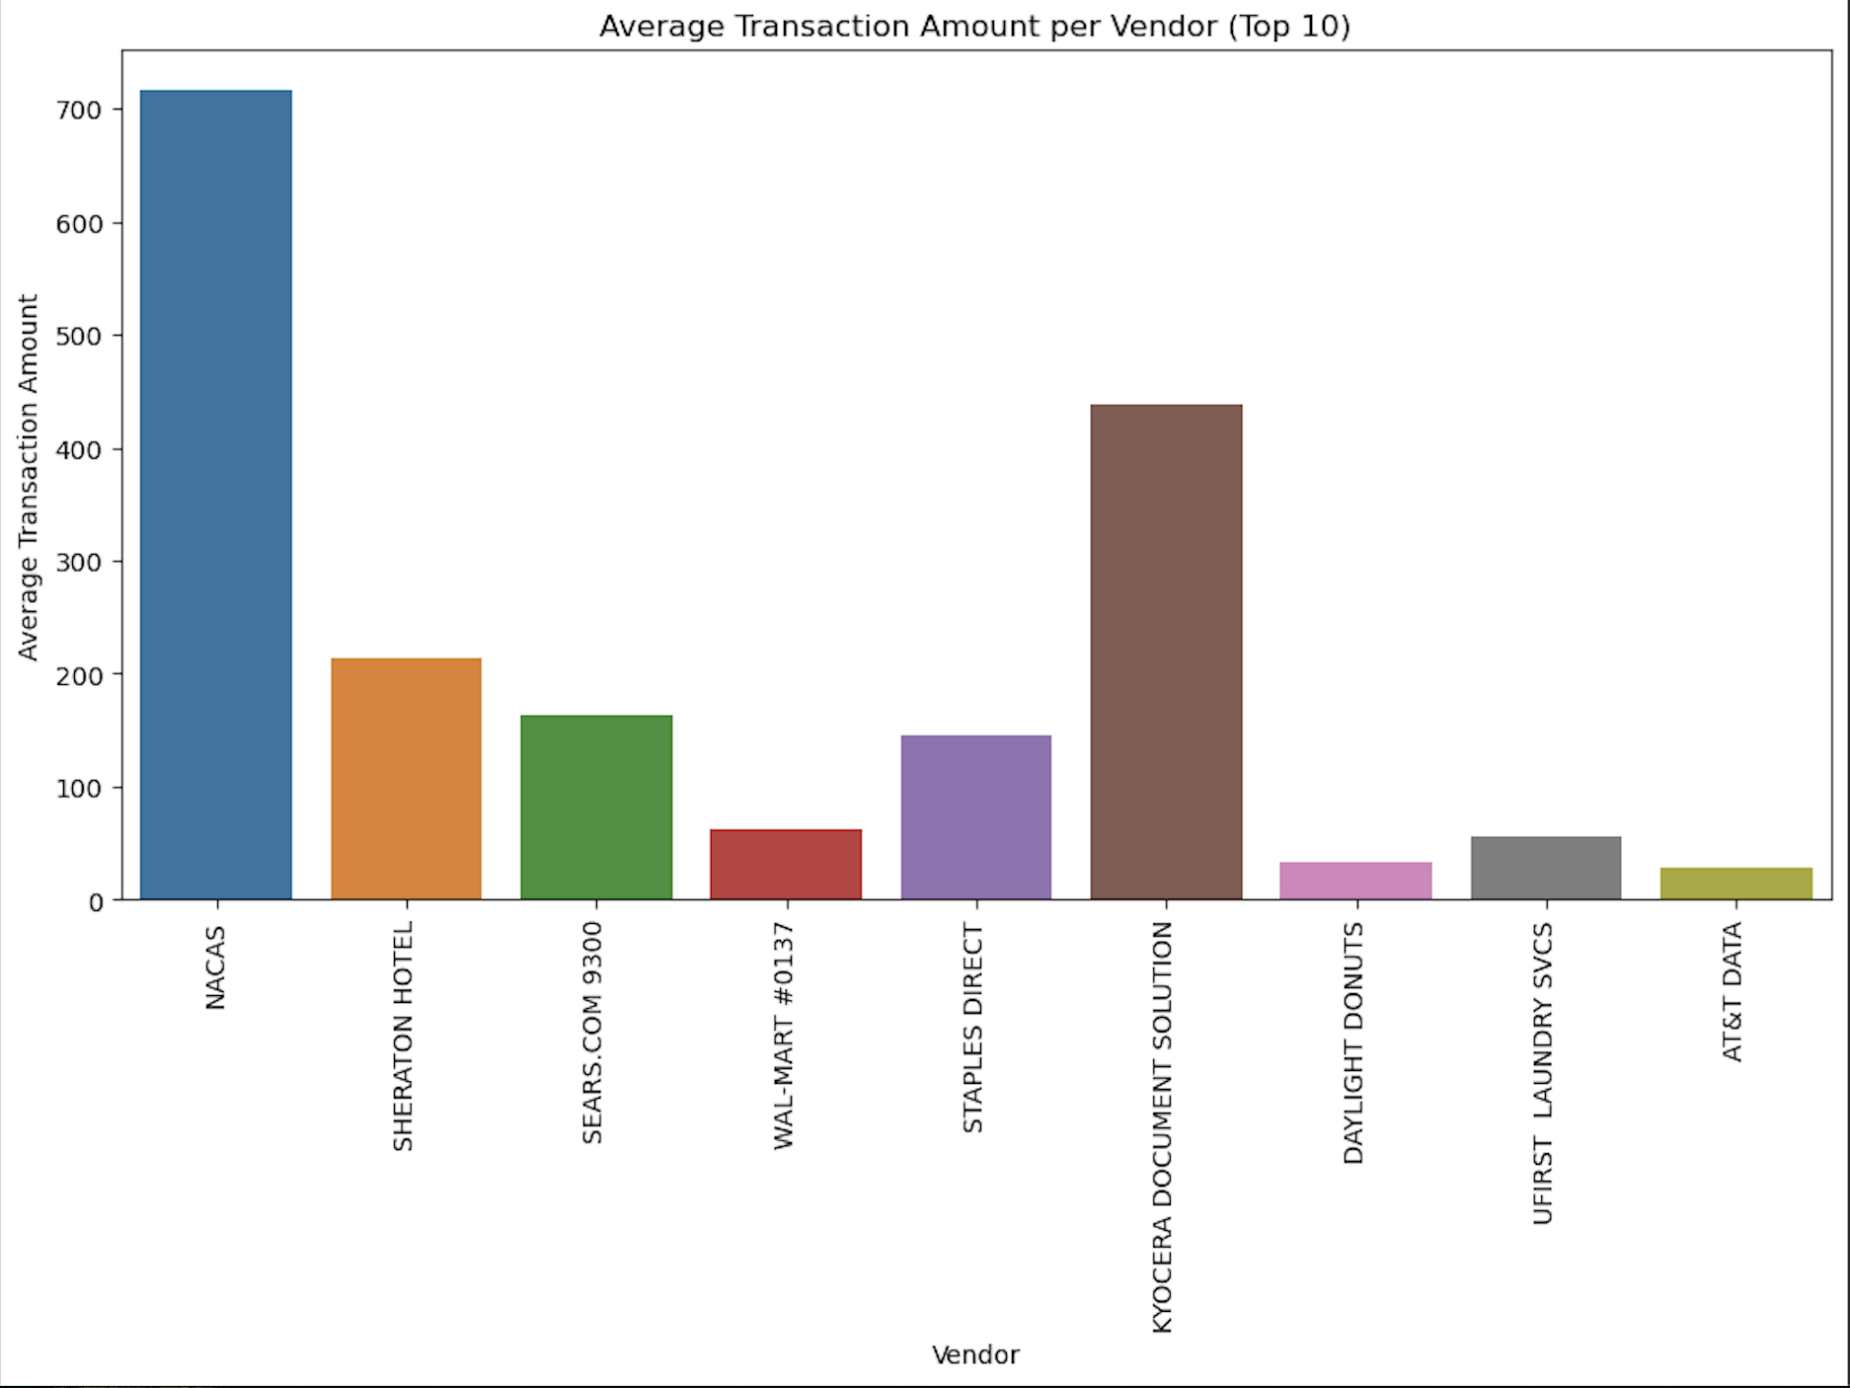
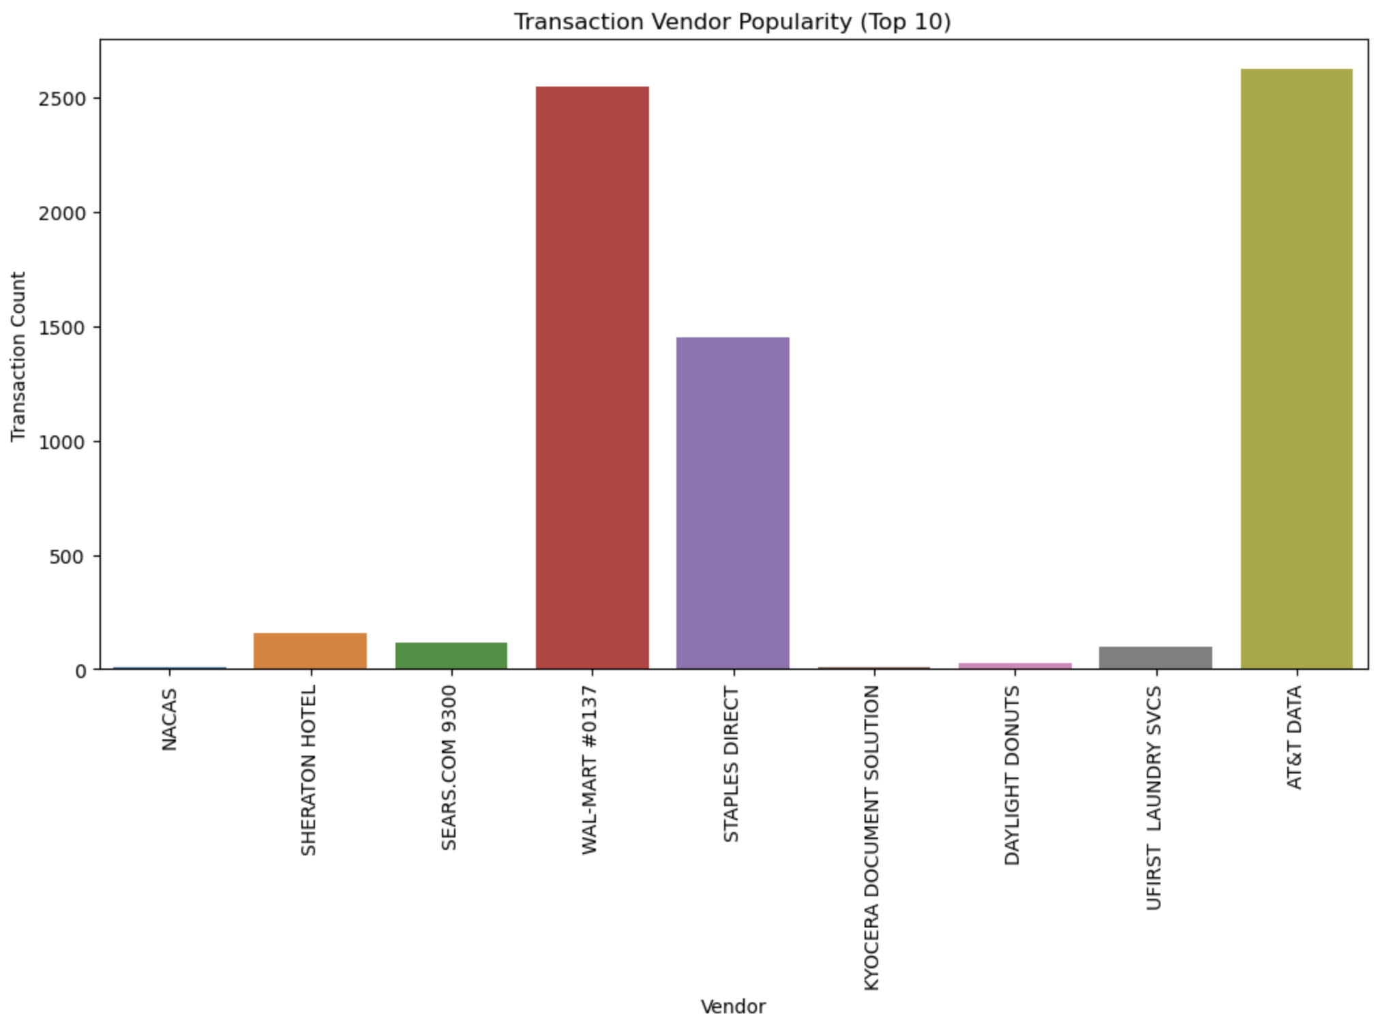
Part2: Key Insights
Anomalies!!!
02
Vendor Analysis
High-Average Transaction Amount: "NACAS" has the highest average transaction amount, followed by "Kyocera Document Solutions" and "Sheraton Hotel."
Vendor Popularity: "AT&T Data" is the most popular vendor based on transaction count.
Transaction Amount vs. Vendor Popularity: Some vendors have transaction amounts that significantly deviate from their popularity, indicating potential irregularities.

Slide 5
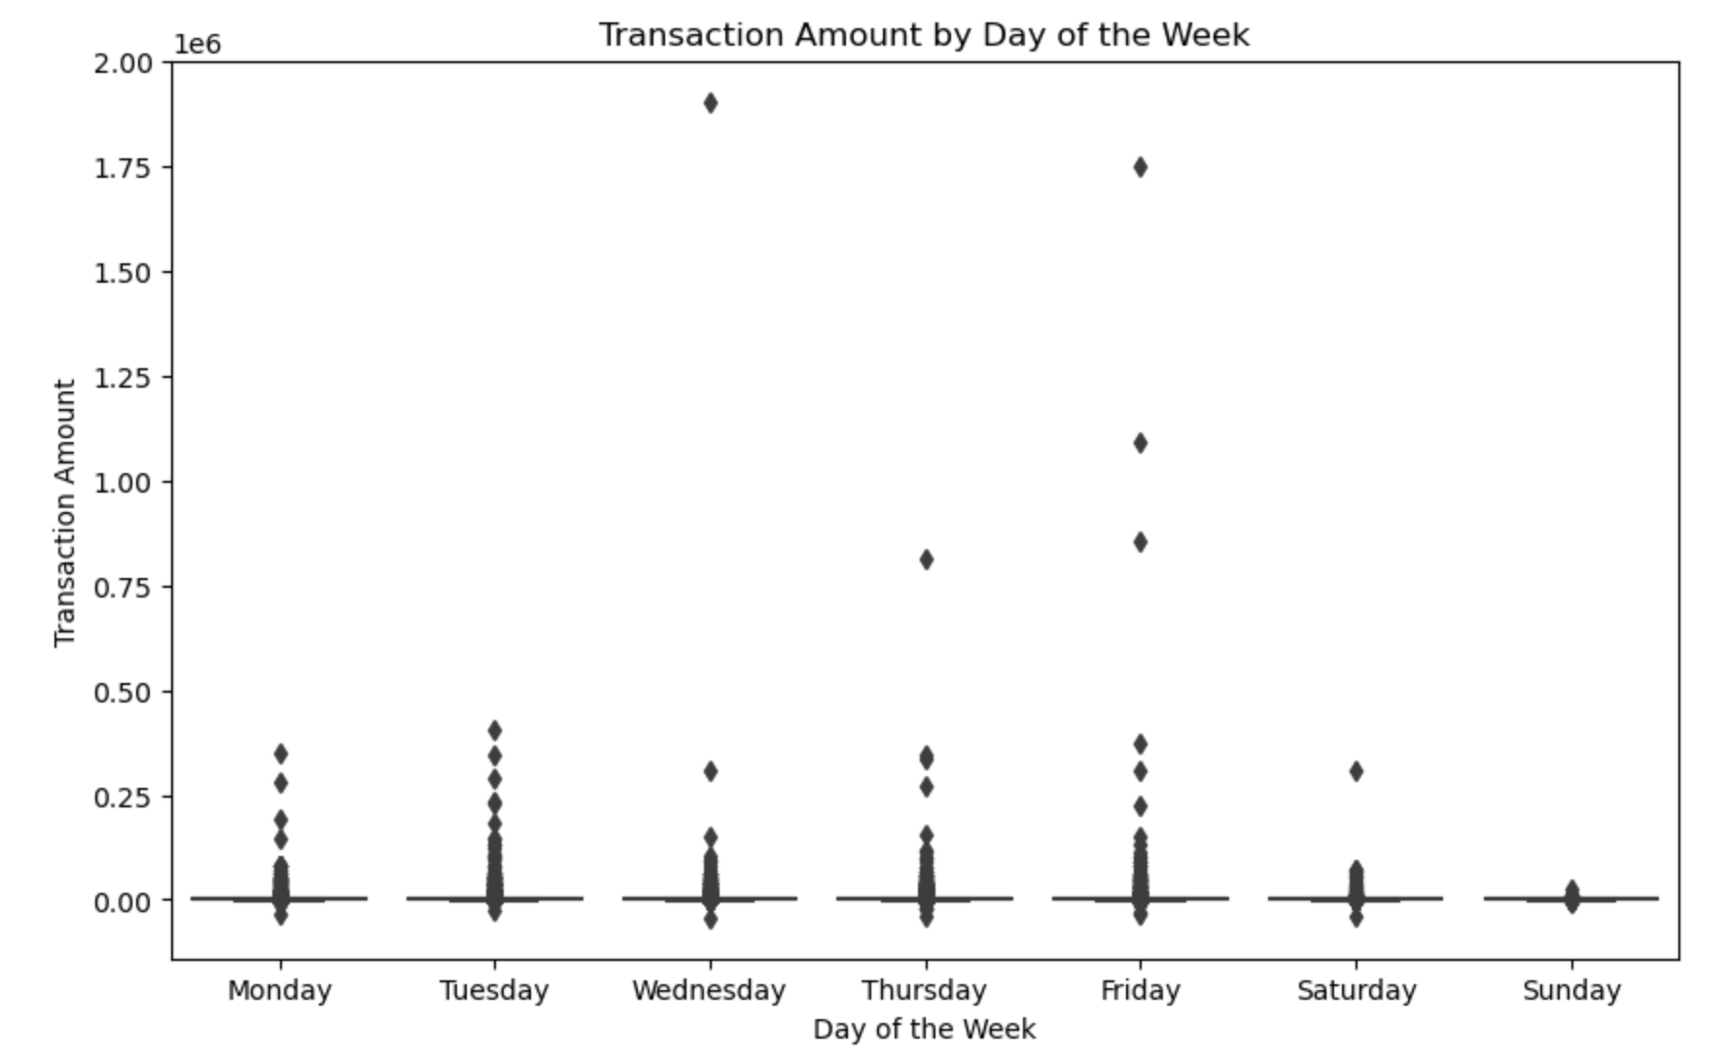
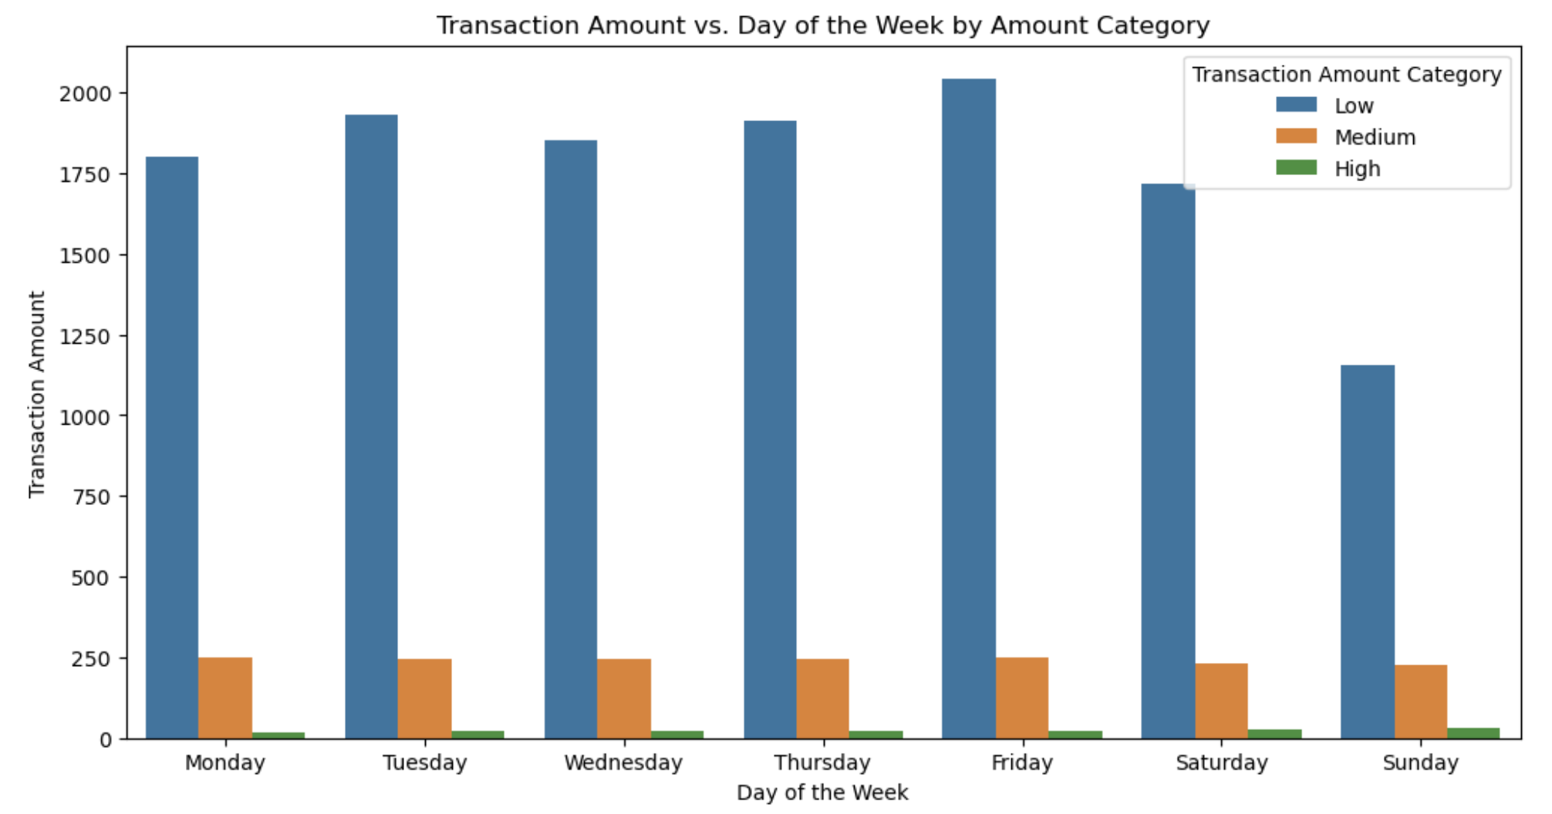
Part2: Key Insights
Anomalies!!!
03
Transaction Amount by Day of the Week
Anomaly Detection: Wednesday (WED), Thursday (THUR), and Friday (FRI) exhibit anomalies with a few transactions having significantly larger amounts. Investigate these outliers to uncover potential issues or opportunities, such as high-value expenses or fraud.
Customer Behavior Analysis: Understand customer behavior trends related to transaction amounts on specific days. Utilize these insights to design loyalty programs or discounts that encourage spending on traditionally slower days.

Slide 6
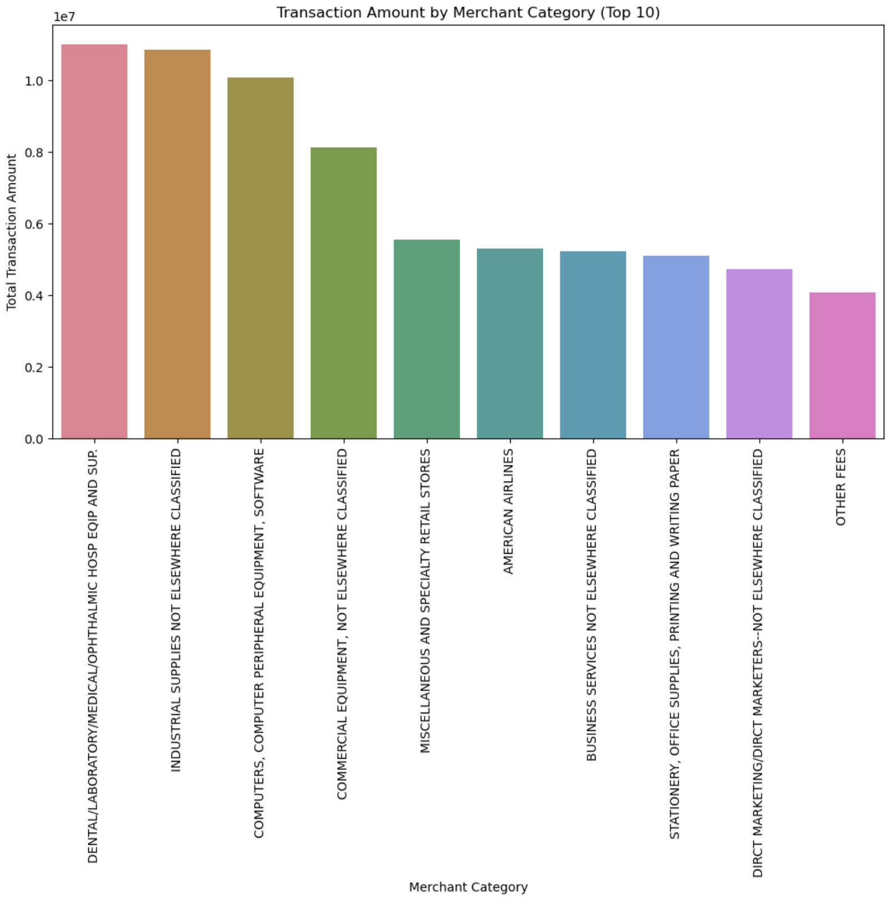
Part2: Key Insights
04
Merchant Category Analysis
Average Transaction Amount by Category: Transaction amounts vary across categories, with some categories having notably higher averages.
Transaction Amount vs. Merchant Category: Some merchant categories exhibit unusual spending patterns compared to the overall average.

Slide 7
Part2: Business Implications
Vendor Performance Evaluation: Identifying high-average transaction vendors allows businesses to focus on lucrative partnerships and negotiations. Detecting discrepancies between vendor popularity and transaction amounts can help identify underutilized or overutilized vendors.
Merchant Category Analysis: Recognizing categories with high transaction amounts can guide marketing and investment strategies. Detecting anomalies in spending within specific categories can help identify irregular expenses or targeted spending.
Temporal Insights: Understanding monthly and weekly transaction patterns can inform inventory management and staffing decisions. Detecting unusual day-to-day transaction variations can prompt investigations into the causes, such as fraud or system glitches.
Cardholder Behavior Analysis: Monitoring transaction counts by cardholders can help identify high-value or high-risk customers. Analyzing transaction amount-to-count ratios can pinpoint individuals with unusual spending behaviors, potentially signaling fraud.
Anomalies Detection: The engineered features enable automated detection of anomalies, reducing the manual effort required to identify irregularities. Early anomaly detection can help businesses mitigate risks, prevent fraud, and improve overall financial performance.

Slide 8
Thank you for watching

